Slide 1
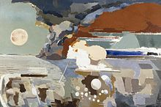
WORLD WAR II GALLERY
Throughout World War II, the relationship amid art and war can be expressed around two key issues. First, art found itself at the centre of an ideological war. Second, during World War II, many artists found themselves in the most tough conditions (in an occupied country, in internment camps, in death camps) and the whole thing are a witness to a influential "urge to create." Such creative instinct can be understood as the expression of self-preservation, a endurance nature in serious times.
Painting by: Paul Nash, 1944

Slide 2
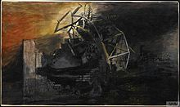
THE CITY HAS FALLEN.
Britain was also theme to radical variances throughout the 1930s nonetheless, it did not agonise suppression nor civic conflict as somewhere else, and might enter World War II with a defensible sense of defensive liberty and consensus. Art had correspondingly trailed the unrestricted look at the heart of novelty, nonetheless radical assumption stood by now required. With the outburst of conflict originated authorised credit of art's use as publicity. Though, in Britain, partisan elevation did not comprise the oppression of inventive liberty in overall. The effort ordered was descriptive, non-bombastic, and frequently of excessive peculiarity appreciations to recognised artistes such as Paul Nash, John Piper, Henry Moore, Graham Sutherland and Stanley Spencer.
Painting by: Graham Sutherland, 1941

Slide 3
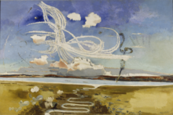
BATTLE OF BRITAIN
Through the past, utmost illustrations of warfare portray martial attainments and frequently display important combat divisions. Nevertheless, in the 19th century a “turn” in the graphic illustration of conflict converted to be distinct. Artistes started to display the calamitous features of conflict, rather of its overvalued occasions and characters. The fight of Britain (1941) signify an act of airborne combat among British and German troops.
Painting by: Paul Nash 1941

Slide 4
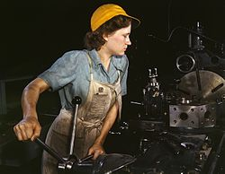
ROSIE THE RIVETER
Rosie the riveter was a cultural image of World War II, signifying the women who toiled in industrial units and shipyards throughout World War II. These women occasionally took completely new jobs substituting the male employees who linked the military. Rosie The riveter is used as a representation of American feminism and women economic benefit.
Painting by: Howard R. Hollem

Slide 5
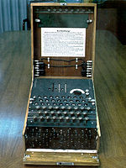
ENIGMA MACHINE
This was a cipher appliance used to code and encode top-secret communications. More accurately, Enigma was a family of related electro-mechanical rotor machines, as well as a variety of diverse replicas. The Enigma was used commercially since the early 1920s on, and was similarly acknowledged by the military and legislative facilities of a number of nations—supreme remarkably by Nazi Germany earlier and throughout World War II. The German soldierly model, the Wehrmacht Enigma, is the form utmost normally debated.
Painting by: Artistic Panda

Slide 6
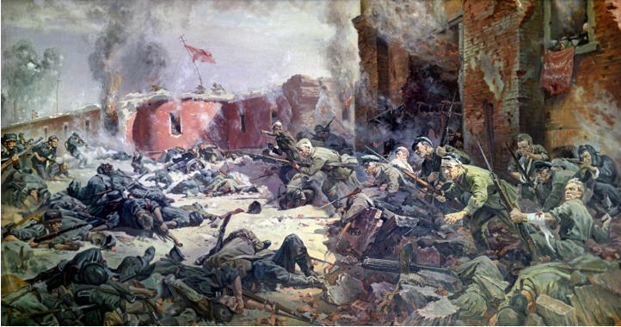
DEFENDERS OF THE BREST FORTRESS
The brest fortress was the soviet place to look at the german incursion on 22 June 1941. it was soon enclosed and left overdue in the back by the proceeding opponent. Pockets of resistance unrelenting existed till late July.
Painting by: Ignatovich O

Slide 7
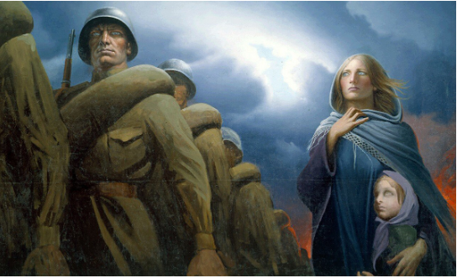
FAREWELL OF SLAVIANKA
The Russian patriotic march, Farewell of Slavianka was inscribed in respect to females going to warfare with their partners to war. The rally was very prevalent equally in the Russian Empire, Soviet Union and is still the most preferred soldierly rally in contemporary Russia.
Painting by: Konstantin Vasilyev, 1974

Slide 8
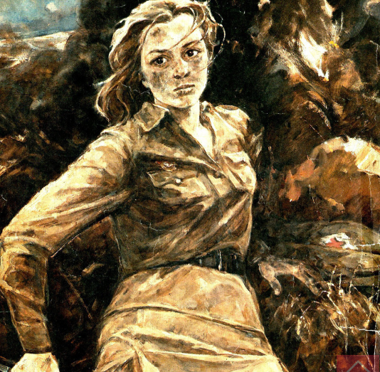
Natasha Kachuevskaya
Natasha was a red Army heroine. Throughout the Fight of Stalingrad nurse Natalya Kachuevskaya protected 20 injured Red Army militaries by single-handedly fighting proceeding opponent groups. Out of ammo, she raged herself and the rival up with the latter grenade.
Painting by: Irina Baldina, 1984

Slide 9
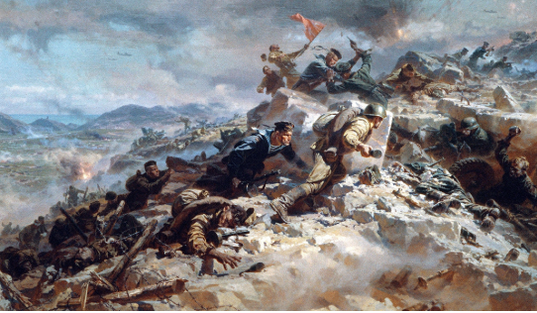
THE STORM OF SAPUN RIDGE
Sapun Ridge was a well-fortified German security place throughout the Soviet deliverance of Sevastopol in May 1944. It required lots of time and abundant gore for the Red Army to take it. After losing this key point the Germans soon lost the entire metropolitan.
Painting by: Alexander Krasavin, 1958

Slide 10
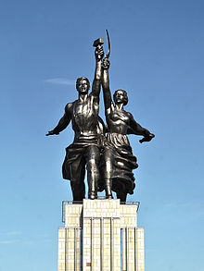
ART IN NAZI GRMANY: THE WORKER AND THE KOLKHOZ WOMAN
In 1937 in Munich, two concurrent proceedings established the Nazis’ opinions around art. One demonstration showed art that ought to be eradicated, though the additional endorsed, by difference, the authorised artistic.
In Europe, additional authoritarian systems accepted a comparable posture on art and heartened or enforced a certified artistic, which was a method of Practicality. At this time Pragmatism denotes to a representative, imitative panache, and not to an art destitute of idealism. Such flair was fastened in a respected custom – prevalent, cheap to comprehend, and therefore applied to publicity aims.
It stood distinct in Stalin’s Soviet Union, anywhere assortment in the fine art stood prohibited and “Socialist Realism” was introduced as the certified flair. Contemporary art was barred as being debauched, conformist and elitist. The comparison of sculptures placed by national pavilions during the 1937 Global Display in Paris is skimpy. The exposition was conquered by the hostility amid Germany and the Soviet Union, through their striking rotundas fronting each other. On one side, Josef Thorak’s statues were exhibited by the German rotunda’s entry. And on the other, Vera Mukhina’s statue, Worker and Kolkhoz Woman, was positioned on top of the Soviet pavilion.
Sculpture By: vera Mukhina, 1937

Slide 11
REFERENCES
Simpson, E. (Ed.). (1997). The spoils of war: World War II and its aftermath: the loss, reappearance, and recovery of cultural property (pp. 272-311). New York: Harry N. Abrams.
Stansky, P., & Abrahams, W. (1994). London's burning: life, death and art in the Second World War (p. 71). London: Constable.
Stein, J. P. (1977). The monetary appreciation of paintings. Journal of political Economy, 85(5), 1021-1035.
Strazdes, D. J., Belnap, G., & Marstine, J. (1992). American paintings and sculpture to 1945 in the Carnegie Museum of Art. Hudson Hills Press.

